Slide 1
COMPUTER SCIENCE PROJECT I-CS691 CLASS NAVIGATOR GUIDANCE BY-PROF HENRY WONG
Our Github Link-
https://github.com/CS691team3/CS691team3project
Our Wiki page link-
https://github.com/CS691team3/CS691team3project/wiki
Team Members
Ameya Kherodkar
Ashutosh Misar
Chinmay Joshi
Kenneth Okereke
Shivam Mattoo

Slide 2
Contents
Problem Statement
Introduction
Objectives
Timeline
Requirements
Technologies
Product Backlog
Test Cases
Breakdown
Diagrams
Implementation
Future Plan

Slide 3

Problem Statement
Students especially new students or people visiting the college for first time find it difficult to locate the place they want to visit

Slide 4
Introduction
Class navigator is an app which will navigate students ,faculty, visitors to their respective destinations in university campus
It navigates users within the school facility using certain images
It will be the cross platform mobile application
This app will provide elegant, aesthetically pleasing panoramic tour to our university

Slide 5
Objectives
This application will help students, faculty, staff navigate Pace University campus using his/her mobile app with the use of certain images that we have captured within the school facility
Our application has start point and destination to navigate
Provide a really cool and comfortable experience for the users

Slide 6
Timeline
Phase I
Phase II
Basic Android/iOS application
Technology review
Industry Type (Education)
Requirement Analysis
MVP Implementation
Trained machine learning model
Image recognition
Backend implementation
User Experience
Product Deployment

Slide 7





Requirements

Slide 8
Android Studio and Xcode
Android Studio is the official integrated development environment for Google's Android operating system, built on JetBrains' IntelliJ IDEA software and designed specifically for Android development
Android studio contains all the Android sDK tools to design, test, debug and profile your app
It is a replacement for the Eclipse Android Development Tools (ADT) as the primary IDE for native Android application development.
Xcode is an integrated development environment for macOS containing a suite of software development tools developed by Apple for developing software for macOS, iOS, watchOS, and tvOS
Swift compiles software more quickly, helps you deliver faster apps, and generates even smaller binaries

Slide 9
Product Backlog
Story ID | User story | Priority | Sprint Backlog | Status
1 | Requirement Gathering and analysis Application Home page Sign Up Page Login Page module | High | 1 | Completed
2 | MVP implementation Forget password module Search module | High | 2 | Completed
3 | Training model using DCNN Creating model using image recognition Test and validate data using DCNN | High | 3 | Incomplete
4 | Product implementation Database connectivity with trained model | High | 4 | Incomplete

Slide 10
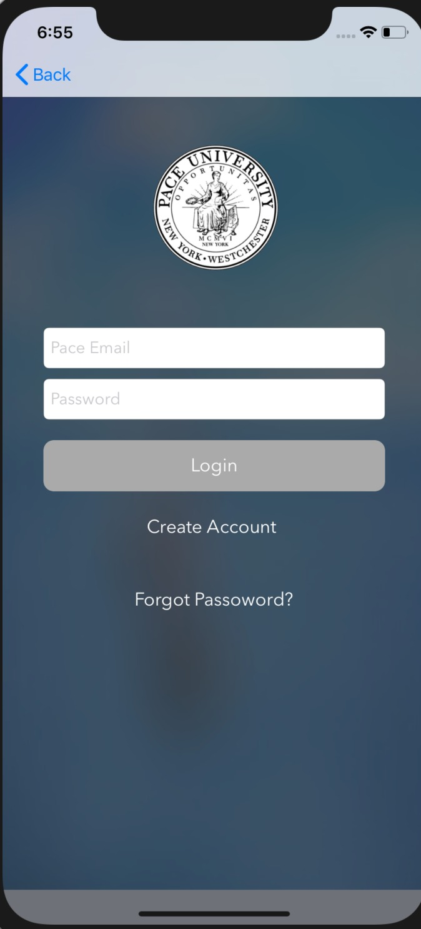
Log in Menu Sign up Menu Forgot password
Sprint [1] | User Story: 1
Home page view | Status : Completed
As a User I must be able to see the home page with login menu.

Slide 11
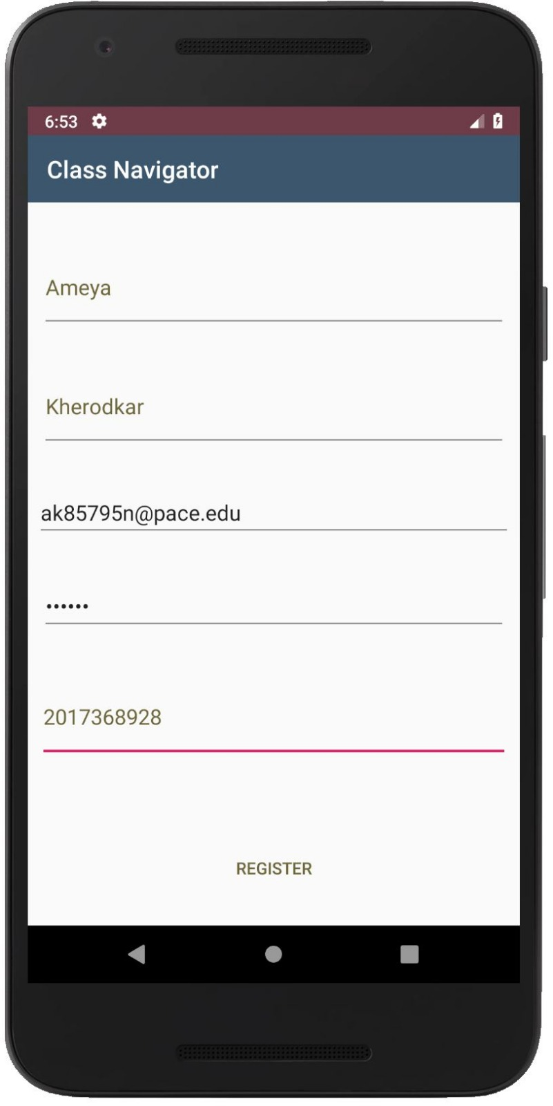
Enter Username Enter Email Enter Password Enter Contact Number
Sprint [1] | User Story: 2
Sign-Up Module | Completed
As a First time user I must be able to successfully
signup for the application

Slide 12
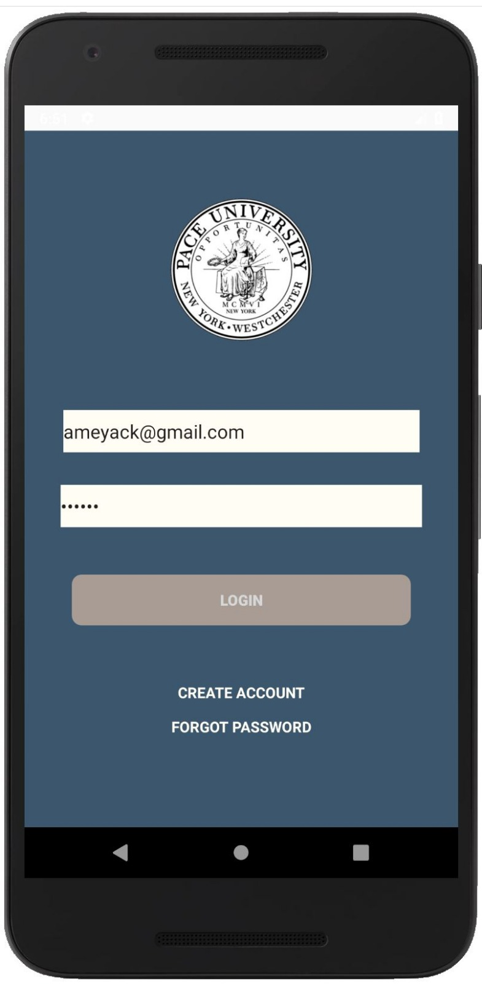
. Login with Username/Email Enter Password Login
Sprint [1] | User Story: 3
Login Module | Completed
As a Valid user I must be able to successfully login into the Application

Slide 13
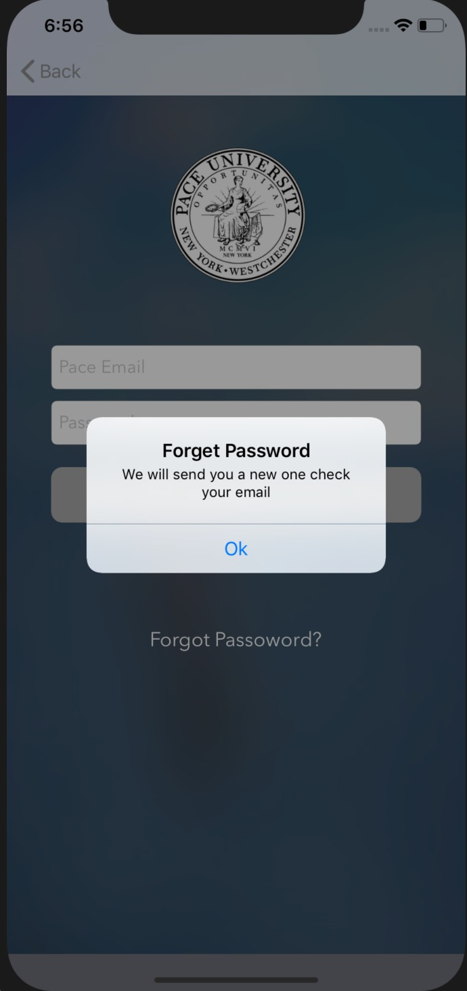
Valid Username/Email Submit
Sprint [2] | User Story: 1
Forgot password Module | Completed
As a Valid user I must be able to successfully
retrieve my password from forgot password menu.

Slide 14
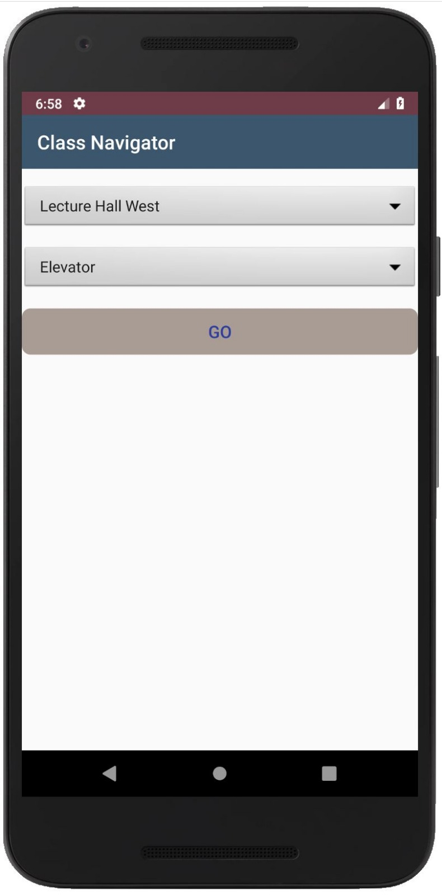
Valid source location Valid destination location
Sprint [2] | User Story: 2
Search Module | Completed
As a Valid user I must able to successfully reach
to destination from source/ start location

Slide 15
Test Cases
Test Case Id | Test case Name | Test case description | Expected output
1. | User Registration/signup | New Users click on signup to be redirected to signup page | Users get redirected to signup page
2. | Creating Account | User enters account information like name, email, phone number, username and password | Signup complete
3. | Phone number | User enters numbers | Phone number accepted
4. | Phone number | User enters characters | Please enter a valid phone number
5. | Password | User enters a password less than 6 digits | Please enter a password 6 digits or greater
6. | Login | User enters correct username and password | Login successful user gets redirected to his account

Slide 16
Test Cases
Test Case Id | Test case Name | Test case description | Expected output
7. | Login | User enters incorrect username or password | Login failed please try again
8. | Search | User clicks on the search button to see list of available destinations | User sees lists of available destinations
9. | Selection | User selects his destination from the available list | Selection complete and list of directions is displayed
10. | Log out | User selects log out | Successfully logged out redirected to login page

Slide 17
Augmented Reality
Augmented reality is an interactive experience of a real world environment where the objects that reside in the real-world are "augmented" by computer-generated perceptual information, sometimes across multiple sensory modalities, including visual, auditory, haptic
The primary value of augmented reality is that it brings components of the digital world into a person's perception of the real world, and does so not as a simple display of data, but through the integration of immersive sensations that are perceived as natural parts of an environment.

Slide 18
Breakdown
September
Research about indoor Space recognition
October
Requirement Gathering
November
Technology review and analysis
Implementation of MVP
December

Slide 19
User Stories
Modules | Description
Sign up | This feature allows user to sign up using personal details
Log In | This features allows user to login to application
Forgot Password | This allows user to reset the password if forgot or misplaced the previous one
Search Option | User can search the destination class to navigate
Destination Reach | “My Camera” application opens up and little dog appears that will guide to respective class/location

Slide 20
Diagrams
Sign Up
Database
Enter personal details
User registered
Login
Select Source
Select Destination
Search Class Instructions

Slide 21
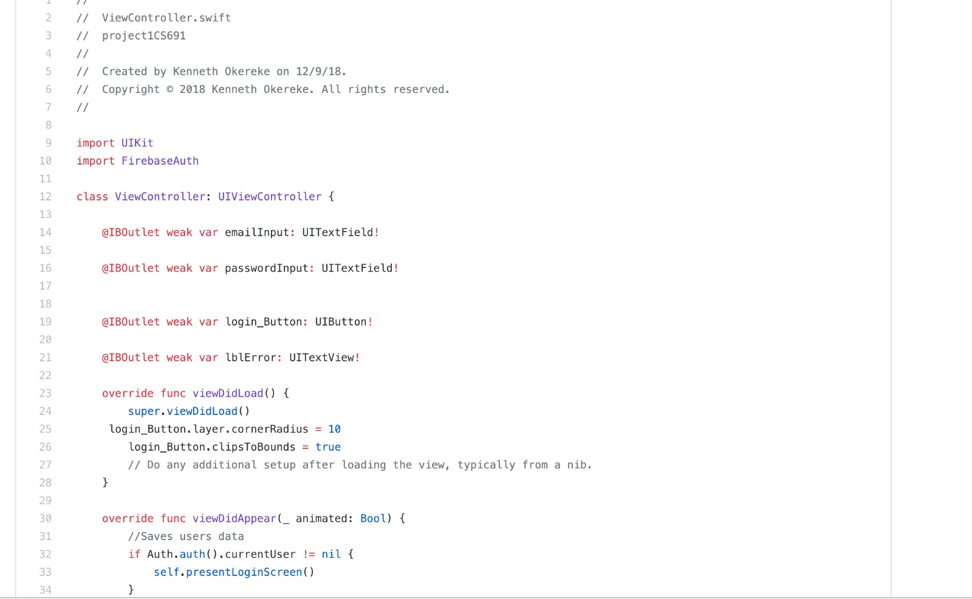
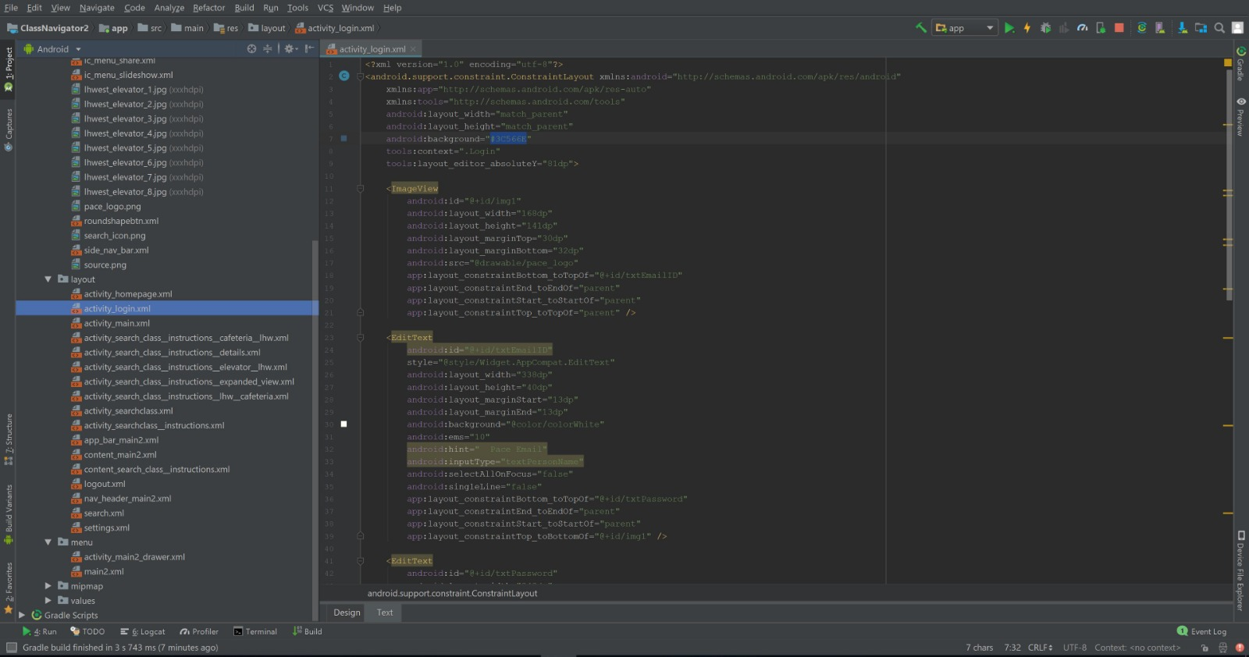
Implementation

Slide 22
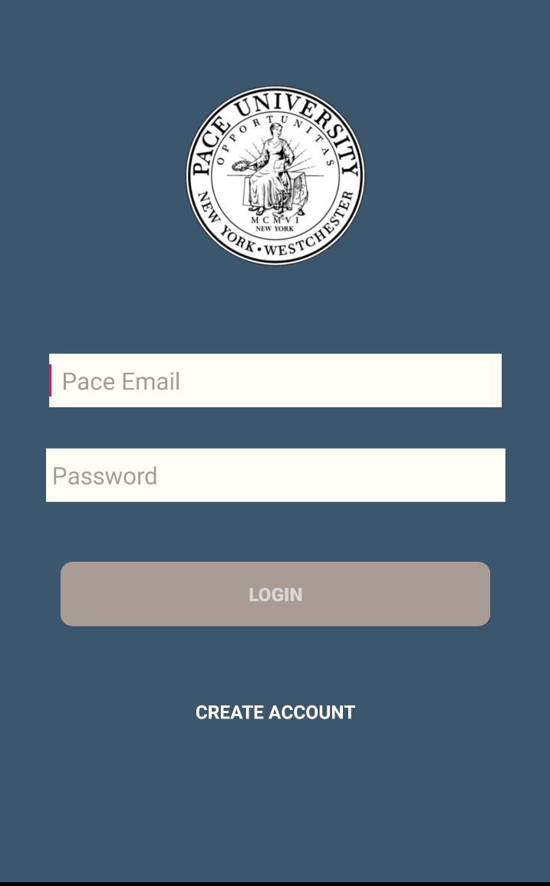
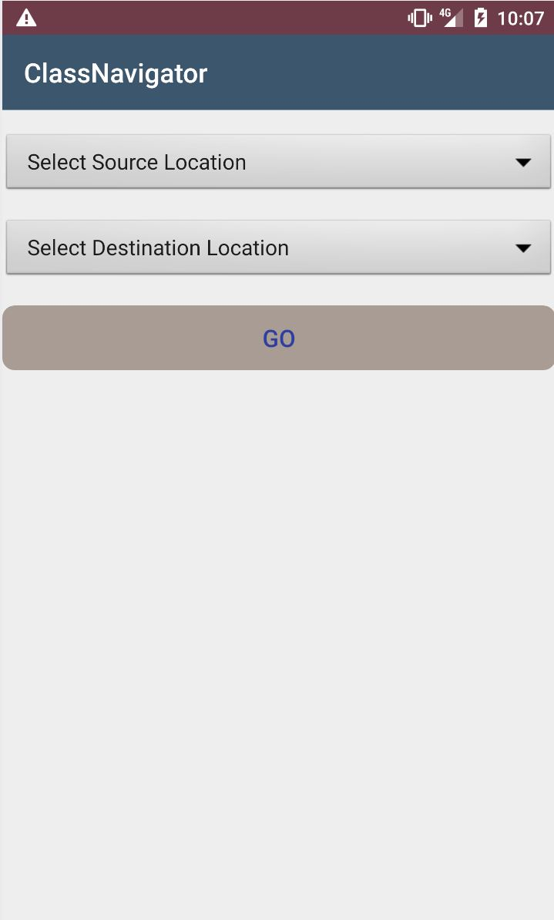
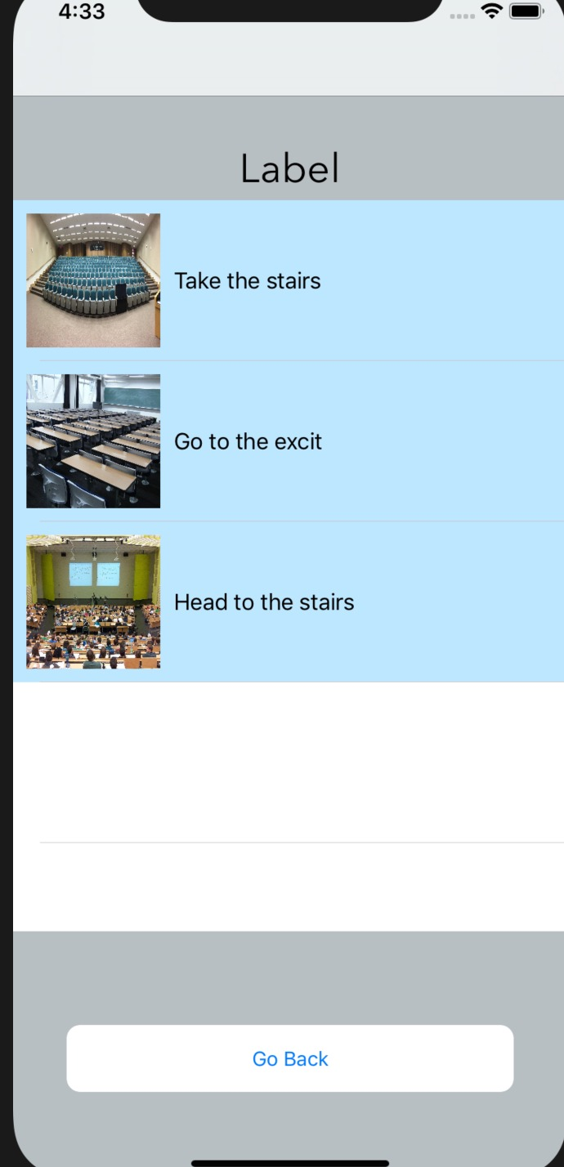
Frontend Implementation

Slide 23
Future Plan
We will be taking videos using commercial camera which generates more stable, clear and high definition video data
We will be designing our DCNN model to interpret and recognize interior space
DCNN model will prove to be an effective approach to perform object detection and scene classification

Slide 24
Image recognition
Image recognition, in the context of machine vision, is the ability of software to identify objects, places, people, writing and actions in images
Computers can use machine vision technologies in combination with a camera and artificial intelligence software to achieve image recognition
Image recognition is used to perform a large number of machine-based virtual tasks such as labelling the content of images with meta-tags, performing image content search and guiding autonomous robots, self-driving cars and accident avoidance systems.
Method for image recognition requires deep machine learning

Slide 25
Deep convolutional neural networks
Convolutional neural networks are deep artificial neural networks that are used primarily to classify images (e.g. name what they see), cluster them by similarity (photo search), and perform object recognition within scenes
Deep convolutional neural networks (DCNNs) are the first class of algorithm that can identify faces, individuals, street signs, tumors, platypuses and many other aspects of visual data.
Convolutional neural networks ingest and process images as tensors, and tensors are matrices of numbers with additional dimensions

Slide 26
Diagrams
Training Phase
Deep Convolutional Neural Network
extract
Images with label
training
Videos
Building level Model for building recognition
Room level model for level area recognition
Service Phase
Sent
Location
Input Photo
to model

Slide 27
Application demo
iOS app demo:
Android Demo:
https://www.youtube.com/watch?v=-PnuyFgTkF0
Firebase backend:
https://www.youtube.com/watch?v=Cz9sB1z05Zo

Slide 28
Thank You !!

